Slide 1

Sprint 1
Data Science Bootcamp
GC

Slide 2
Sentiment Analysis for Mental Health: A Data Science Approach
Non-Technical Overview: My area of interest lies in understanding public sentiment surrounding mental health issues as expressed on social media platforms. In today's digital age, mental health is increasingly discussed online, where individuals often share their experiences, seek support, or express opinions on mental health topics. Despite the wealth of data available, there is a significant challenge in accurately gauging the overall sentiment of these discussions. The key problem I aim to address is how to automatically and accurately analyze these sentiments to understand the broader public perception of mental health issues. This could potentially highlight areas where more awareness or support is needed, and identify trends that could inform mental health advocacy and policy-making.
Problem Statement: Leveraging advanced machine learning and natural language processing (NLP) techniques to analyze vast amounts of textual data from social media and other platforms. This analysis can uncover insights into public sentiment around mental health issues, identify key topics of discussion, and track how these sentiments evolve over time.

Slide 3
Data Science Vision for Sentiment Analysis
Proposed Solution:
The ability to automate the analysis of sentiment in mental health-related conversations.
Approach Overview:
Scalability: Sentiment analysis can process and analyze large datasets, making it possible to understand public sentiment on a massive scale—far beyond what manual analysis could achieve.
Timeliness: By applying real-time sentiment analysis, organizations can respond quickly to shifts in public mood, enabling more agile and effective interventions.
Contextual Understanding: Beyond simple positive or negative labels, sentiment analysis can provide a nuanced understanding of the public's feelings about specific mental health topics, such as depression, anxiety, or stigma.
Data-Driven Insights: Sentiment analysis can transform unstructured text data into actionable insights, helping to inform decisions in mental health advocacy, public health campaigns, and policy development.

Slide 4
Potential Impact
Real-time Monitoring: Develop tools that can monitor social media in real-time to detect shifts in public sentiment about mental health issues.
Targeted Mental Health Campaigns: By understanding the emotional tone and key topics in public discourse, mental health organizations can tailor their communication strategies to address specific concerns, counteract stigma, and promote mental health awareness more effectively.
Policy and Decision-Making: Policymakers can use insights from sentiment analysis to inform mental health policies that resonate with the public's needs and concerns.
Support for Mental Health Professionals: Mental health professionals can benefit from understanding the broader social context in which their patients operate.

Slide 5
Dataset Overview & Exploratory Data Analysis (EDA)
Datasets Introduced:
Kaggle Datasets: Sentiment Analysis for Mental Health.
Sentiment140 Dataset: Contains 1.6 million tweets labeled as positive, negative, or neutral, and can be used to train sentiment analysis models
Mental Health Tweets Dataset: A specific dataset containing tweets related to mental health, which can be useful for fine-tuning the sentiment analysis model to focus on mental health topics.
Reddit Mental Health Dataset: Contains posts from mental health-related subreddits, which can provide more in-depth discussions and context compared to Twitter data.
Google Trends Data: Can be used to track the popularity of mental health-related search terms over time, providing an additional layer of analysis to complement social media data.

Slide 6
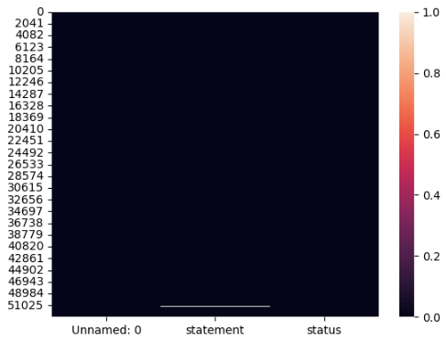
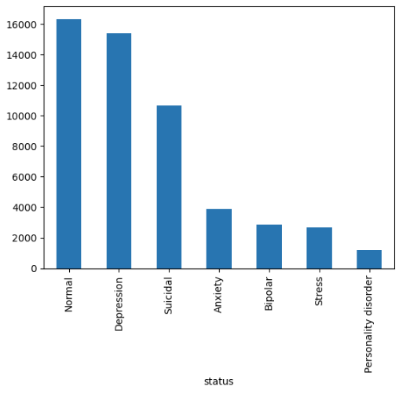
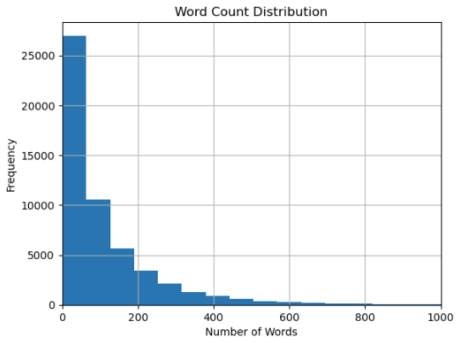
Dataset Overview & Exploratory Data Analysis (EDA)
Preliminary EDA Findings using the Sentiment Analysis for Mental Health dataset (Kaggle):
The preliminary EDA of the "Sentiment Analysis for Mental Health" dataset highlights missing data in the statement column, a diverse distribution of mental health statuses, and a predominance of short text entries typical of social media.

Slide 7
Next Steps in Data Processing and Modeling
Data Processing:
Text Preprocessing: Continue cleaning and preparing the text data (tokenization, stopword removal).
Feature Engineering: Create features from the processed text data (e.g., TF-IDF vectors).
Baseline Modeling:
Initial Model: Start with a baseline sentiment analysis model (e.g., Logistic Regression).
Model Evaluation: Evaluate the model's performance using metrics like accuracy, precision, and recall.
Integration & Analysis:
Merge Sentiment Analysis model to automatically classify posts as positive, negative, or neutral, providing a real-time gauge of public sentiment.
Refinement: Based on initial findings, refine models and explore more advanced techniques if necessary.

Slide 8
Thank you
GC

Slide 9
Sprint 2: Predicting Depression Using Demographic and Lifestyle Data
Data Science Capstone Project
BrainStation
Gennaro Costantino
October 2024

Slide 10
Initial Approach & Dataset Shift
New Direction - Key Features + Target:
Age: The age of the respondent.
Income: Standardized income data for the individual.
Smoking Status: Whether the respondent is a current, former, or non-smoker.
Physical Activity Level: Indicates whether the respondent has a sedentary, moderate, or active lifestyle.
Employment Status: Reflects whether the individual is employed or unemployed.
History of Mental Illness: Indicates whether the individual has a history of mental illness. (TARGET)
Family History of Depression: Information about the presence of depression in the respondent's family.
Chronic Medical Conditions: Whether the individual suffers from chronic health conditions.
Alcohol Consumption & Dietary Habits: Data on the individual's alcohol consumption and dietary preferences.
Initially started with a text-based sentiment analysis approach using social media data.
Challenge: The lack of a target variable led to a shift in the project direction.
New Direction: Pivoted to using a structured depression dataset from Kaggle, which contain a target variable related to mental health outcomes.
Notes:
I went after a structured dataset and found one still related to mental health and using demographic and lifestyle data

Slide 11
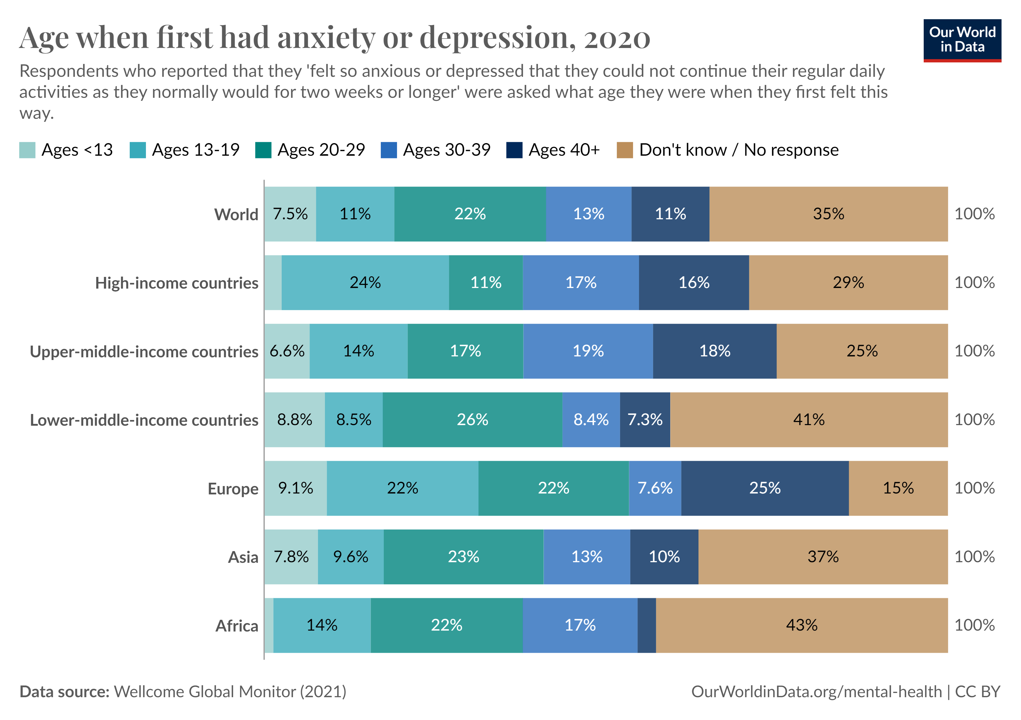
Problem Statement
Mental health disorders, particularly depression, are on the rise globally.
Early prediction of individuals at risk can help in timely interventions.
The goal of this project is to predict depression risks using demographic and lifestyle data.

Slide 12
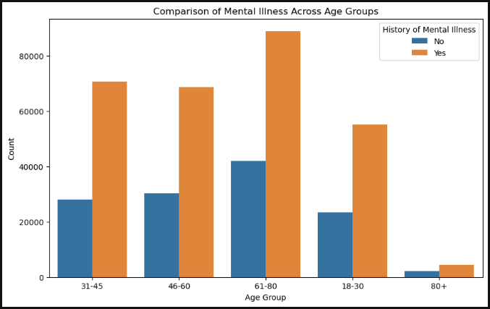
Key Insights from EDA
Age: Older individuals (61+) showed a higher likelihood of reporting mental health issues.
Income: Lower income groups had a higher proportion of mental illness.
Employment: Those unemployed or inactive had higher risks of mental illness.
Other factors: Physical activity and alcohol consumption patterns showed distinct differences. PENDING
Notes:
Exploratory data analysis

Slide 13
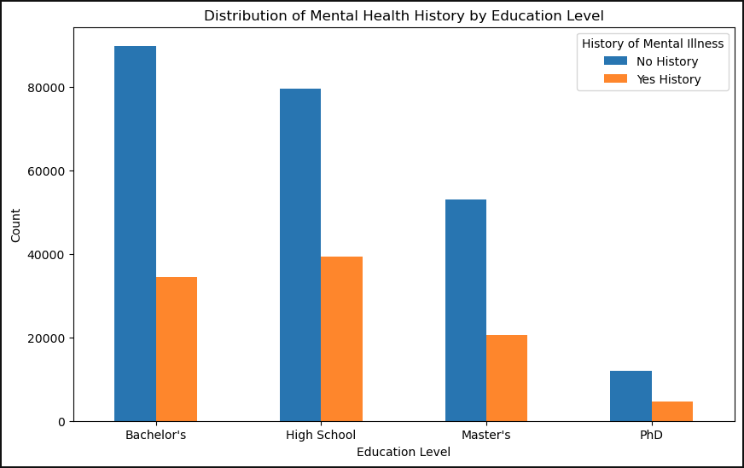
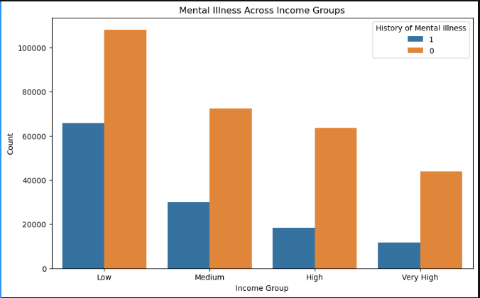

Slide 14
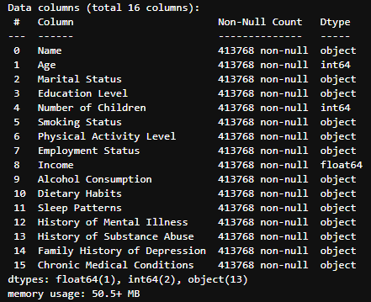
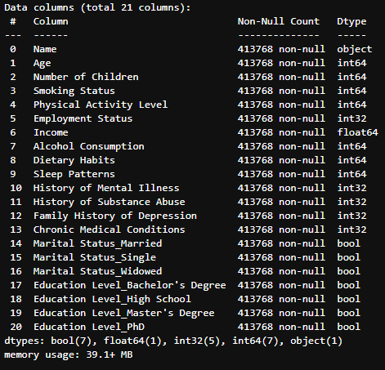
Feature Engineering & Preprocessing
Handling missing values, encoding categorical features, and scaling numerical columns like income.
One-hot encoding applied to marital status and education levels.
Data split into training and testing sets for model building.
Notes:
Encoding Categorical Features:
Why: Machine learning models typically require numerical input. Categorical features, like "Marital Status" or "Education Level," need to be converted to numerical format for the models to interpret them.
What we did: Applied one-hot encoding to convert categories into a binary matrix (for example, "Married" becomes a 1 or 0 in the respective column). This allows the model to treat categories as separate binary features.
3. Scaling Numerical Columns:
Why: Some numerical features, such as income, can have large value ranges. Models like logistic regression and others that rely on distance-based measures can perform poorly if certain features dominate due to their large values.
What we did: Applied feature scaling to normalize features like "Income" so they have a mean of 0 and standard deviation of 1, ensuring all numerical features are on the same scale and contributing equally to model performance.

Slide 15
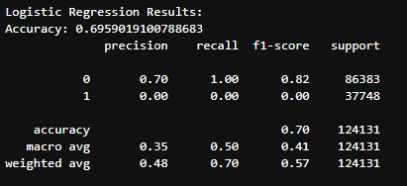
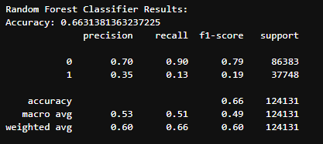
Model Selection – 1st interaction
Logistic Regression
Random Forest
Performance Metrics: Accuracy, Precision, Recall, F1-score
Notes:
And the reason we see 0% for class 1 is because I encoded the target

Slide 16
Hyperparameter Tuning – NEXT STEPS
Parameters tuned for Logistic Regression:
Regularization strength (C)
Solver (lbfgs, liblinear)
Explore Neural Networks to improve prediction accuracy.
Generate new features from existing data, such as age and income brackets.
Deployment: Build a dashboard or web app for real-time monitoring of individuals at risk. EXTRA!
Continue to evaluate model generalization with new test sets.

Slide 17
Thank you
GC

